Slide 1
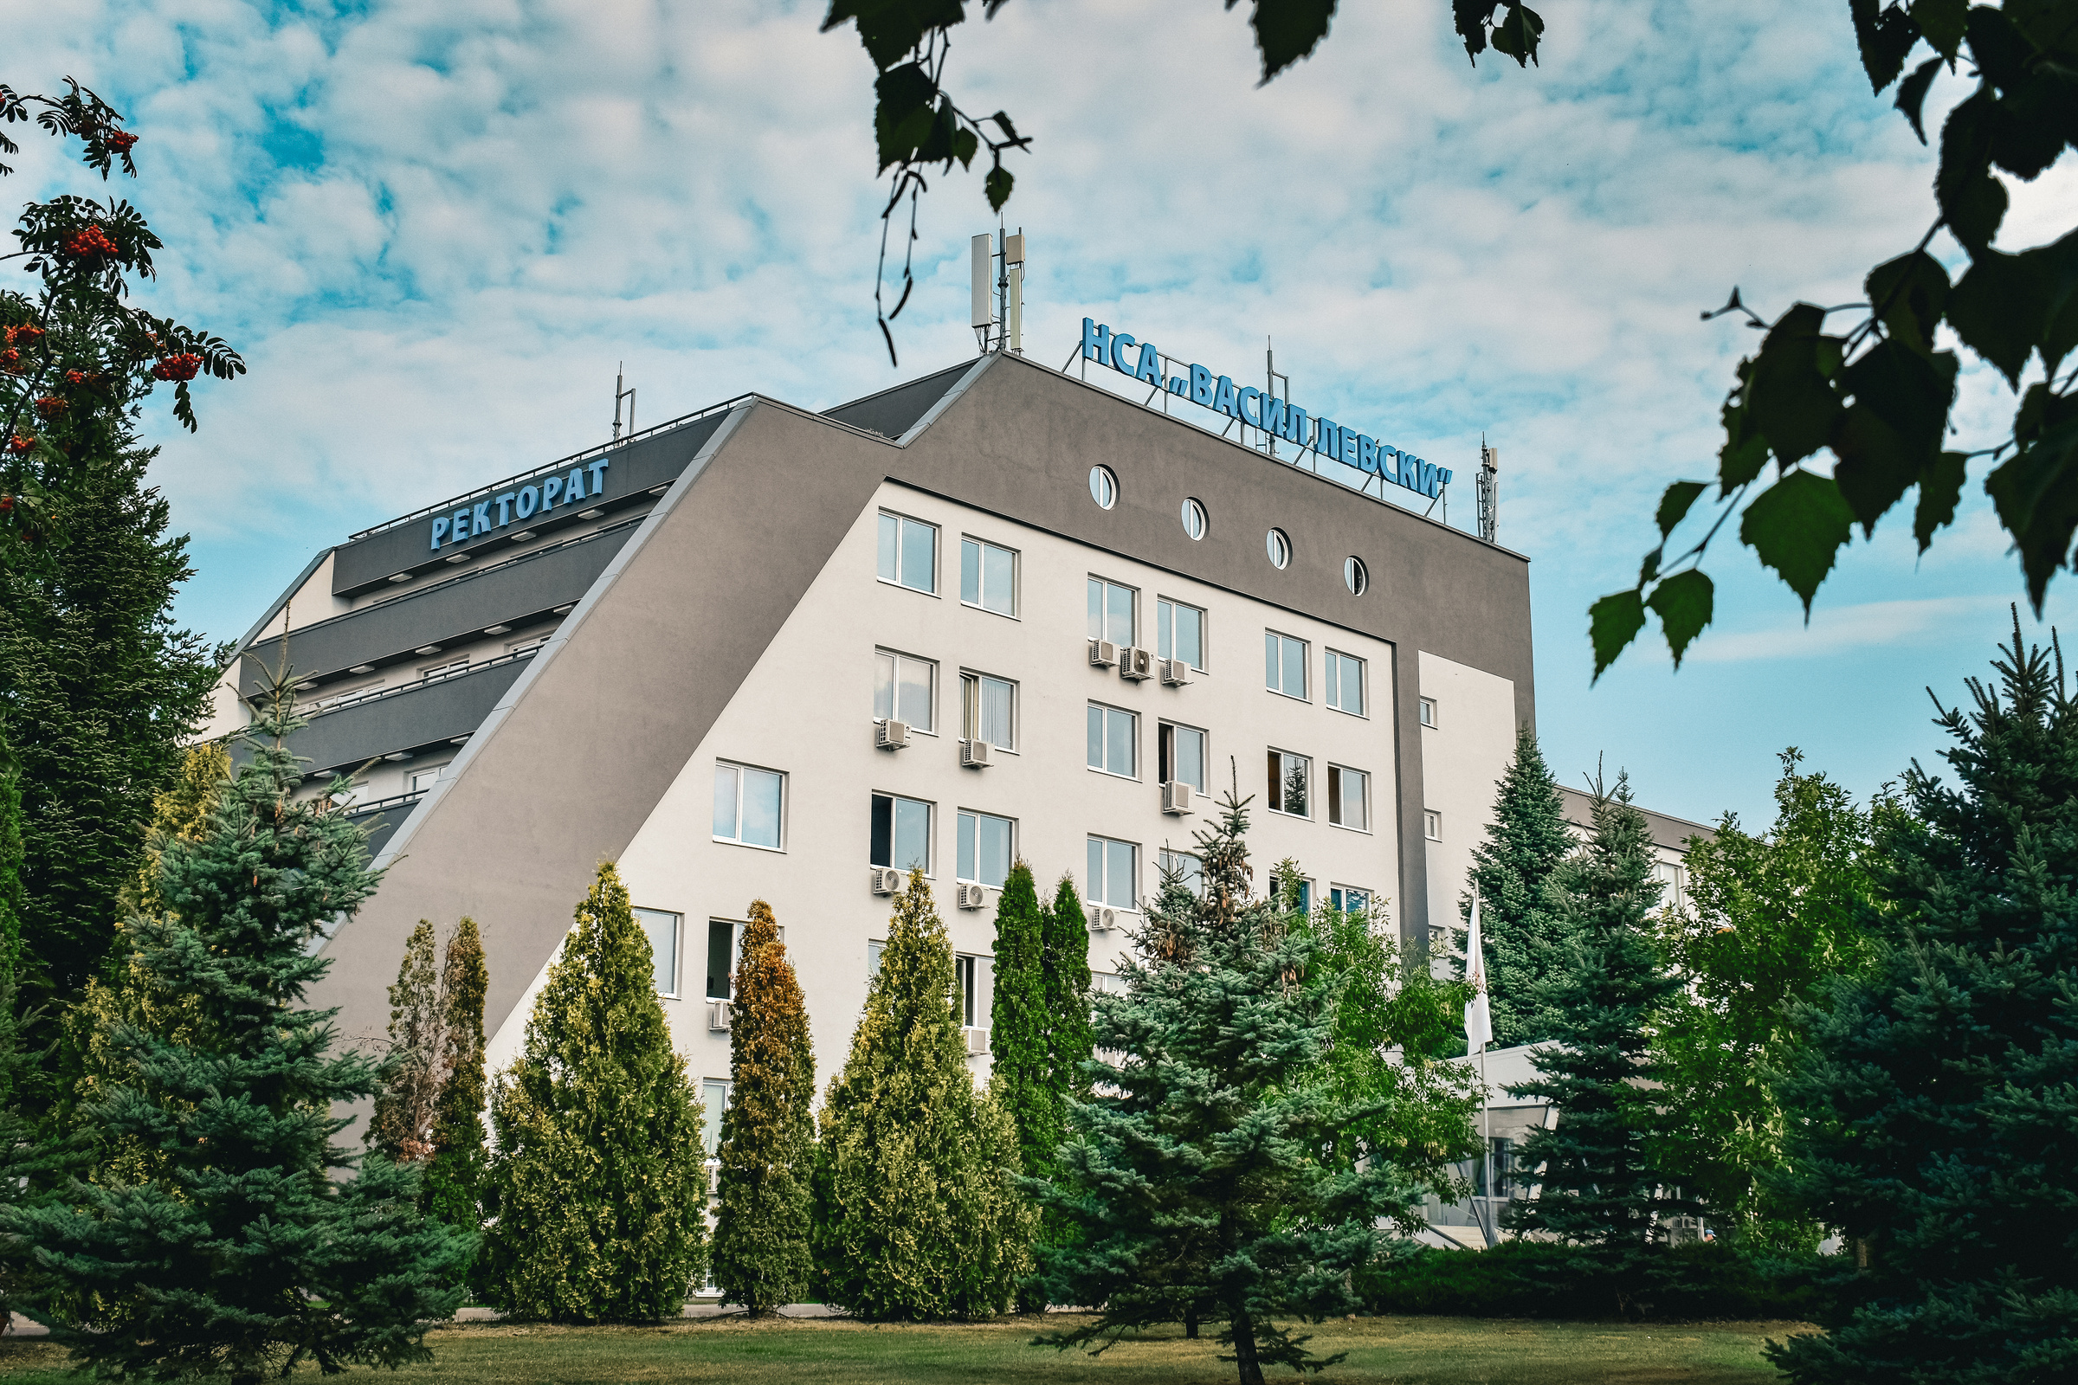


National Sports Academy
"Vassil Levski”
Visit Our Website
nsa.bg

Slide 2
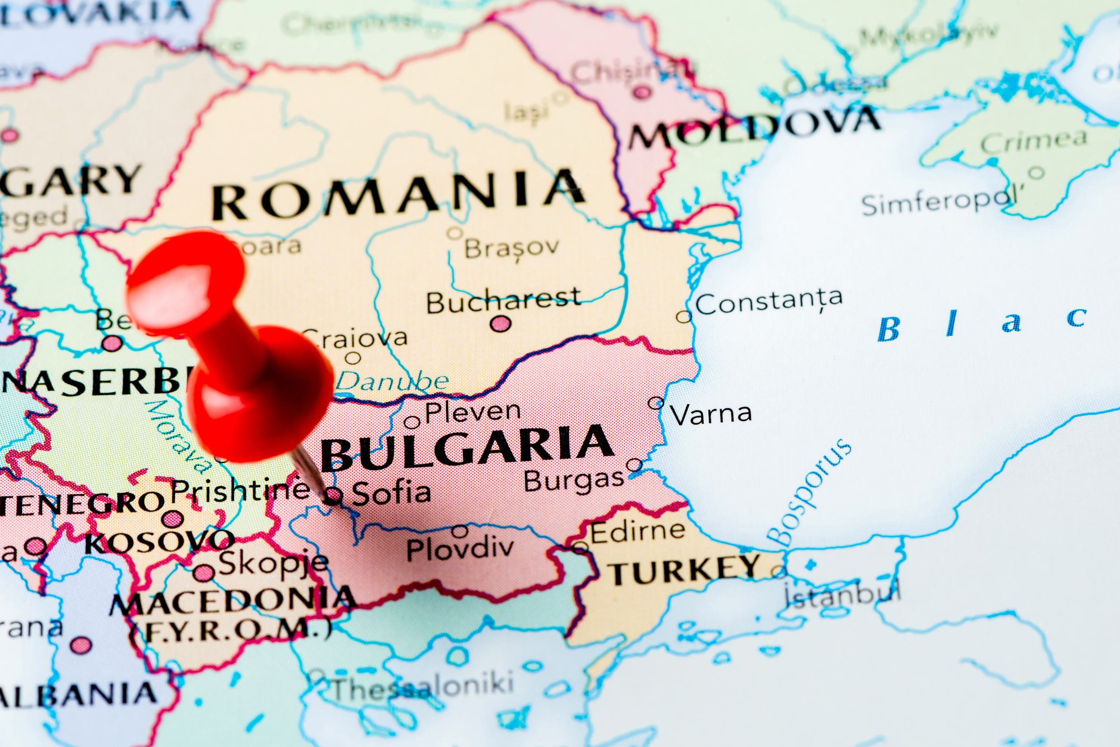


BULGARIA
Bulgaria is a country in Southeast Europe. Located west of the Black Sea and south of the Danube river, Bulgaria is bordered by Romania to the north, Serbia and North Macedonia to the west, Greece and Turkey to the south.
Sofia is the capital and the largest city. The city also hosts 23 of Bulgaria's 51 higher education establishments and more than 105,000 university students

Slide 3

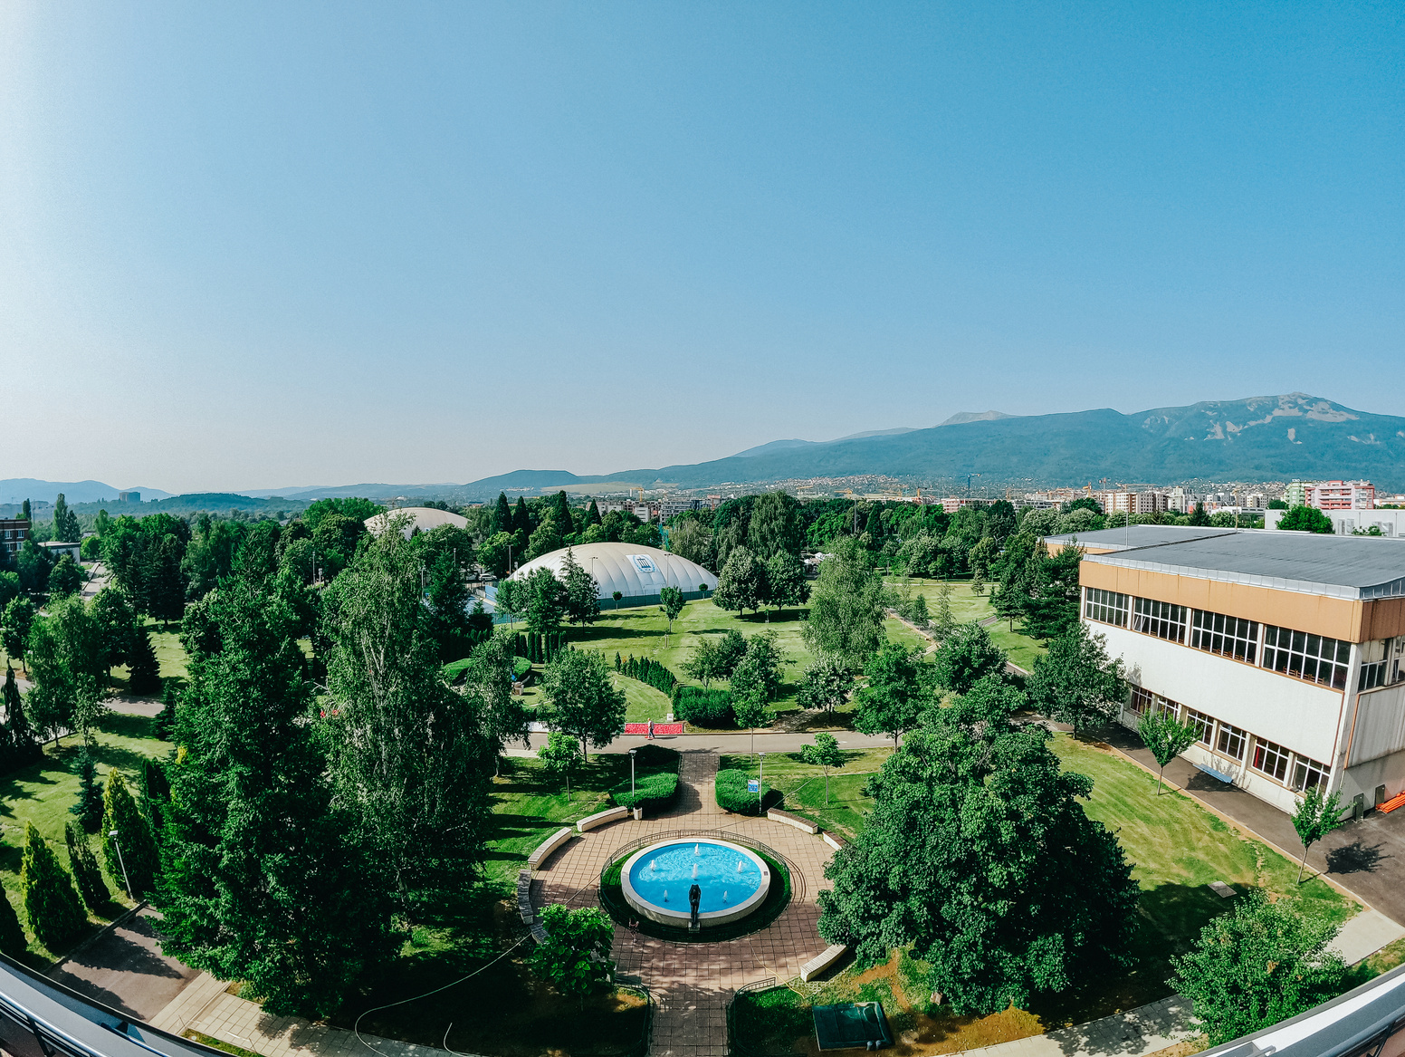
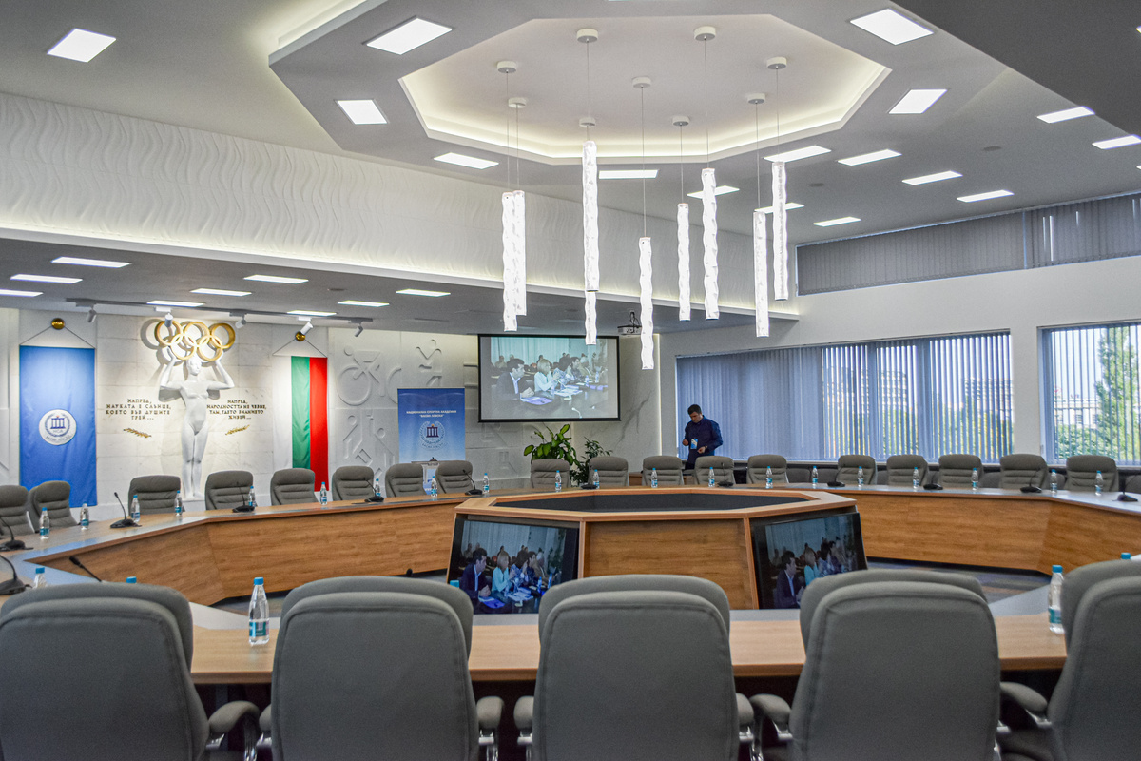
National Sports Academy “Vassil Levski”
The National Sports Academy “Vassil Levski”, usually referred to as the NSA, is Bulgaria's leading higher education institution specialized in teaching physical education, sports and physiotherapy. It is named after the national hero Vassil Levski.
The Academy was established in 1942 by a decree of Tsar Boris III as the Higher School for Physical Education. It was named Higher Institute for Physical Education and Sport from 1953 to 1995. In 1995, by decision of the National Assembly, it was renamed the National Sports Academy. Discover a new, modernly-equipped educational building in the Student Town in Sofia.

Slide 4
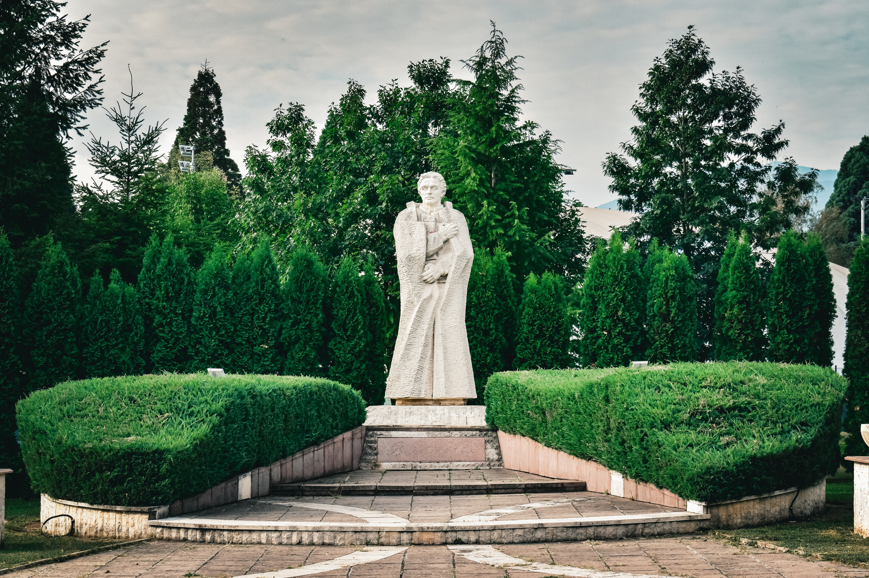
80 years of experience in sports higher education and science
•State-owned university, specialized in sport teaching
•Forms of studying: full-time, part-time, distance, individual
•Fully harmonized with the Bologna system
•Provides education at the three qualification degrees – Bachelor (240 ECTS), Master (60 ECTS), Doctor (3 years)
•Continuous qualifications – short-term and long-term

Slide 5











Education structure
Faculty of Sport
Coach in a kind of sport (68 sports)
Sports Manager
Sports commentator
Combat-applied physical training and sport in the Armed Forces and the Ministry of Interior
Faculty of Physical Education
Teacher in Physical education
Faculty of Public Health, Health Care and Tourism
Department of IT and Language training
Physiotherapy
Nurse
Sports Animation
Adapted Physical Activity
Center for postgraduate qualification
Practical training units – within the academy and on a contract basis
The Centre for Postgraduate Qualification at the National Sports Academy "Vassil Levski" offers different types and forms of training for acquiring additional qualification or improving the qualification of personnel in the field of physical education, sports and related activities.

Slide 6
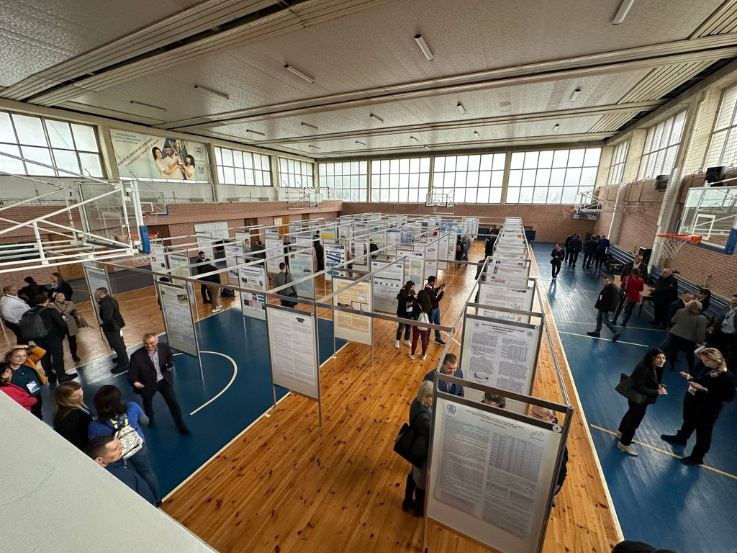

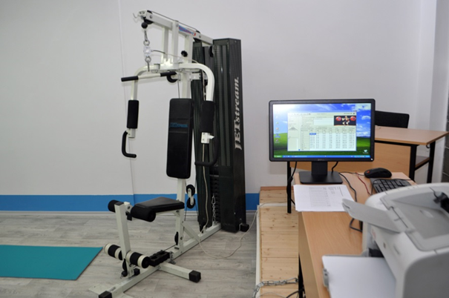
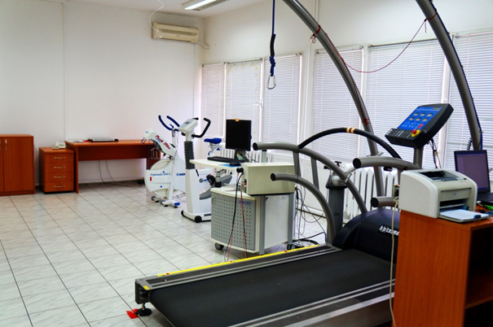
Science & Research
Center for applied research in sport
Library
Project work in science, research and consultancy work
Research work for doctoral studies
Conferences at institutional, national and international level
Journals for sports science
Research networks

Slide 7









International relations
Strategy for internationalization
Bilateral agreements
ERASMUS+
International events
•Erasmus mobility exchanges of students, tachers and staff
•Erasmus+ partner projects
•International scientific and education events
•International training and contest events
Scientific projects
Foreign students at the three educational degrees

Slide 8
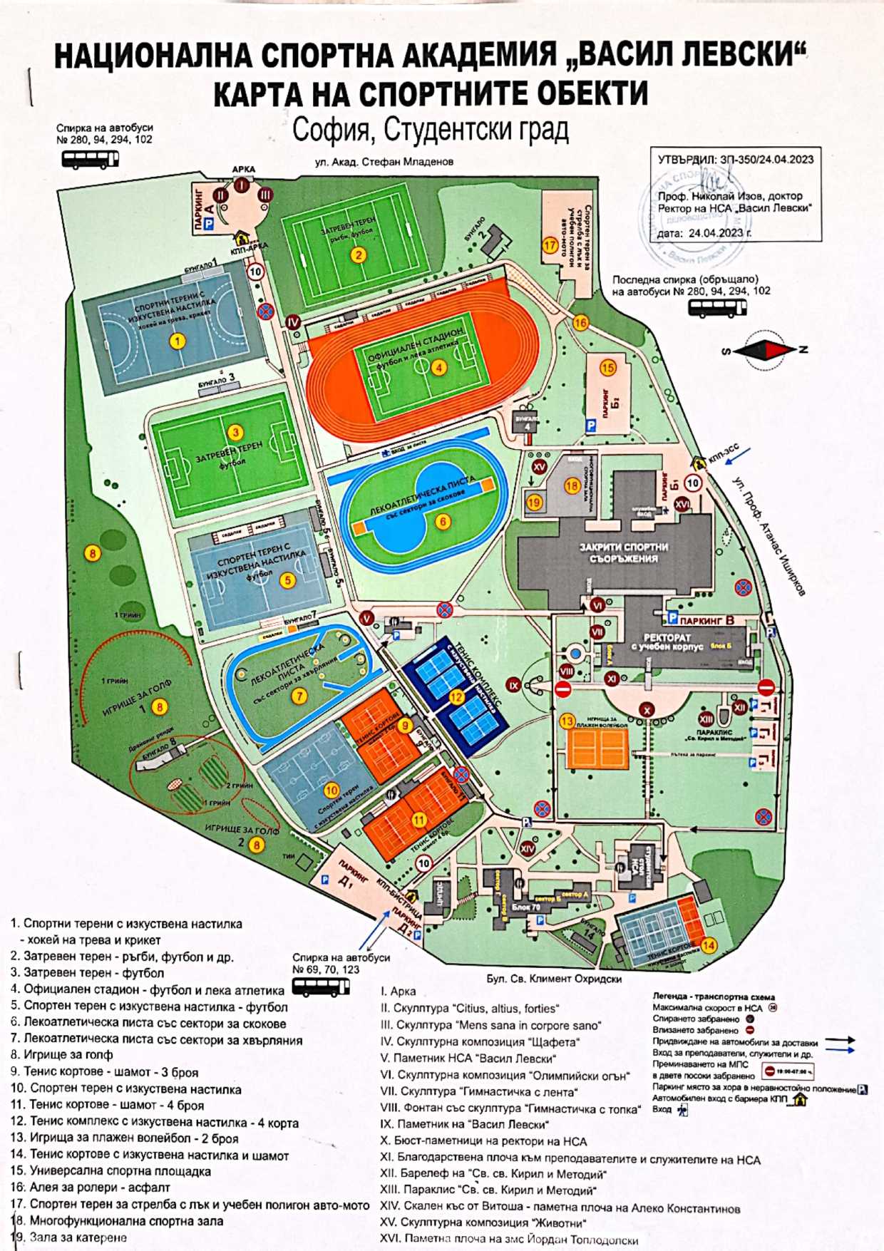
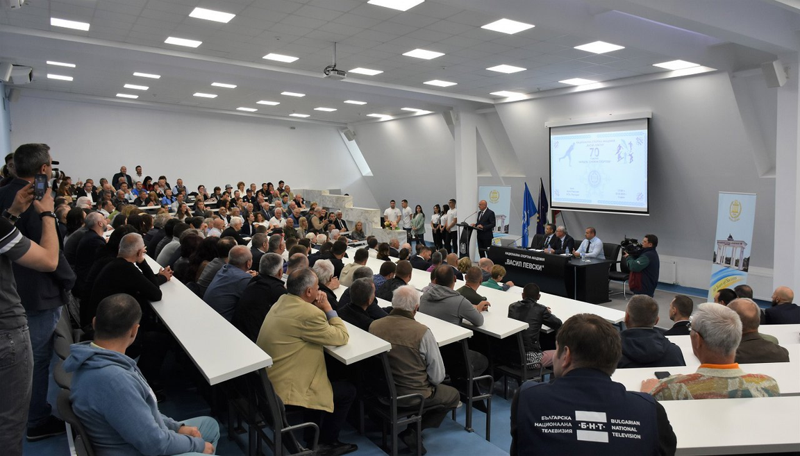
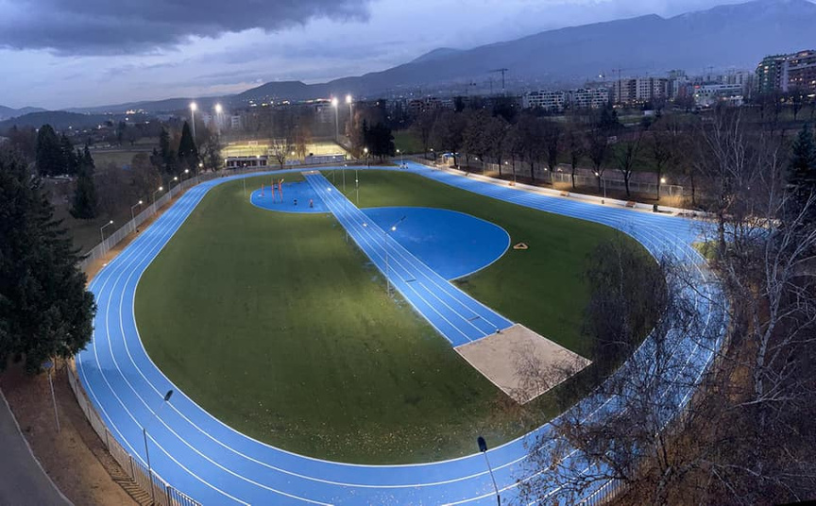
Training Centers And Facilities
•The campus of the NSA consists of 3 study buildings and open training facilities
•14 sports halls
•5 stadiums with natural and artificial covering
•3 track-and-fields stadiums
•Indoor running track
•Swimming pool
•Multifunctional hall
•Golf course etc.

Slide 9
Training Centers And Facilities

Slide 10
Training Centers And Facilities

Slide 11
Training Centers And Facilities

Slide 12
Training Centers And Facilities

Slide 13
Training Centers And Facilities

Slide 14
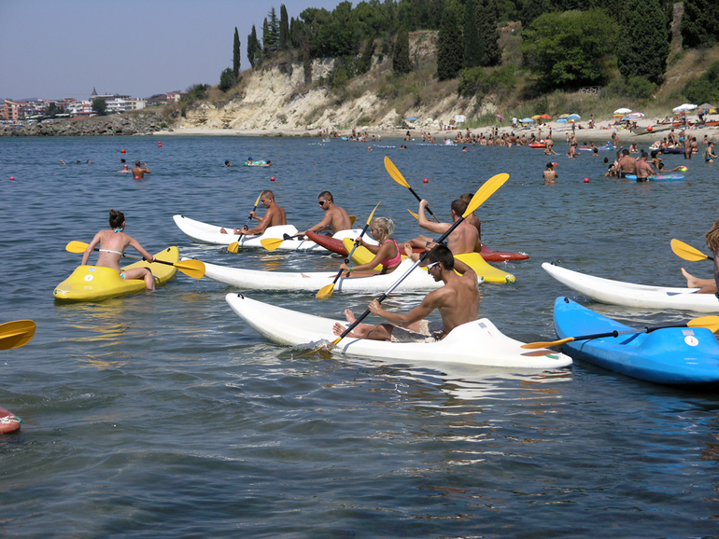
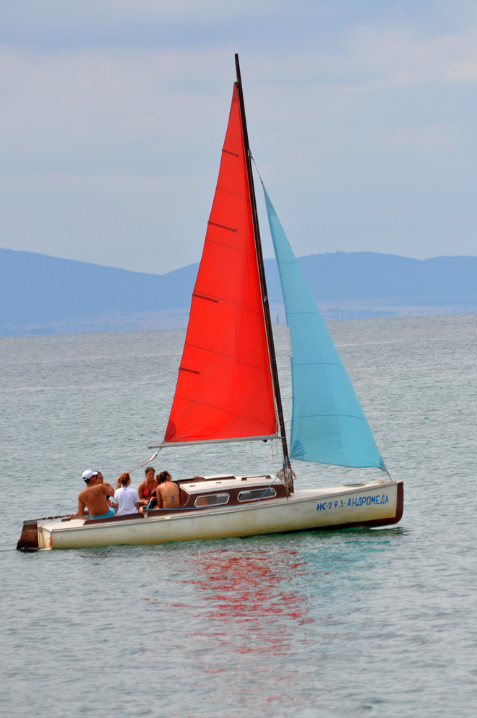

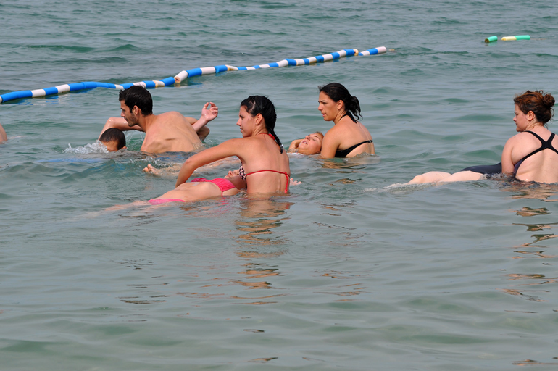
Education and Training outside Sofia
Water Campus
Seaside near the town of Nessebar
(swimming, boating, sailing, water polo, synchronized swimming, canoeing and water skiing, water sports for disabled people)

Slide 15
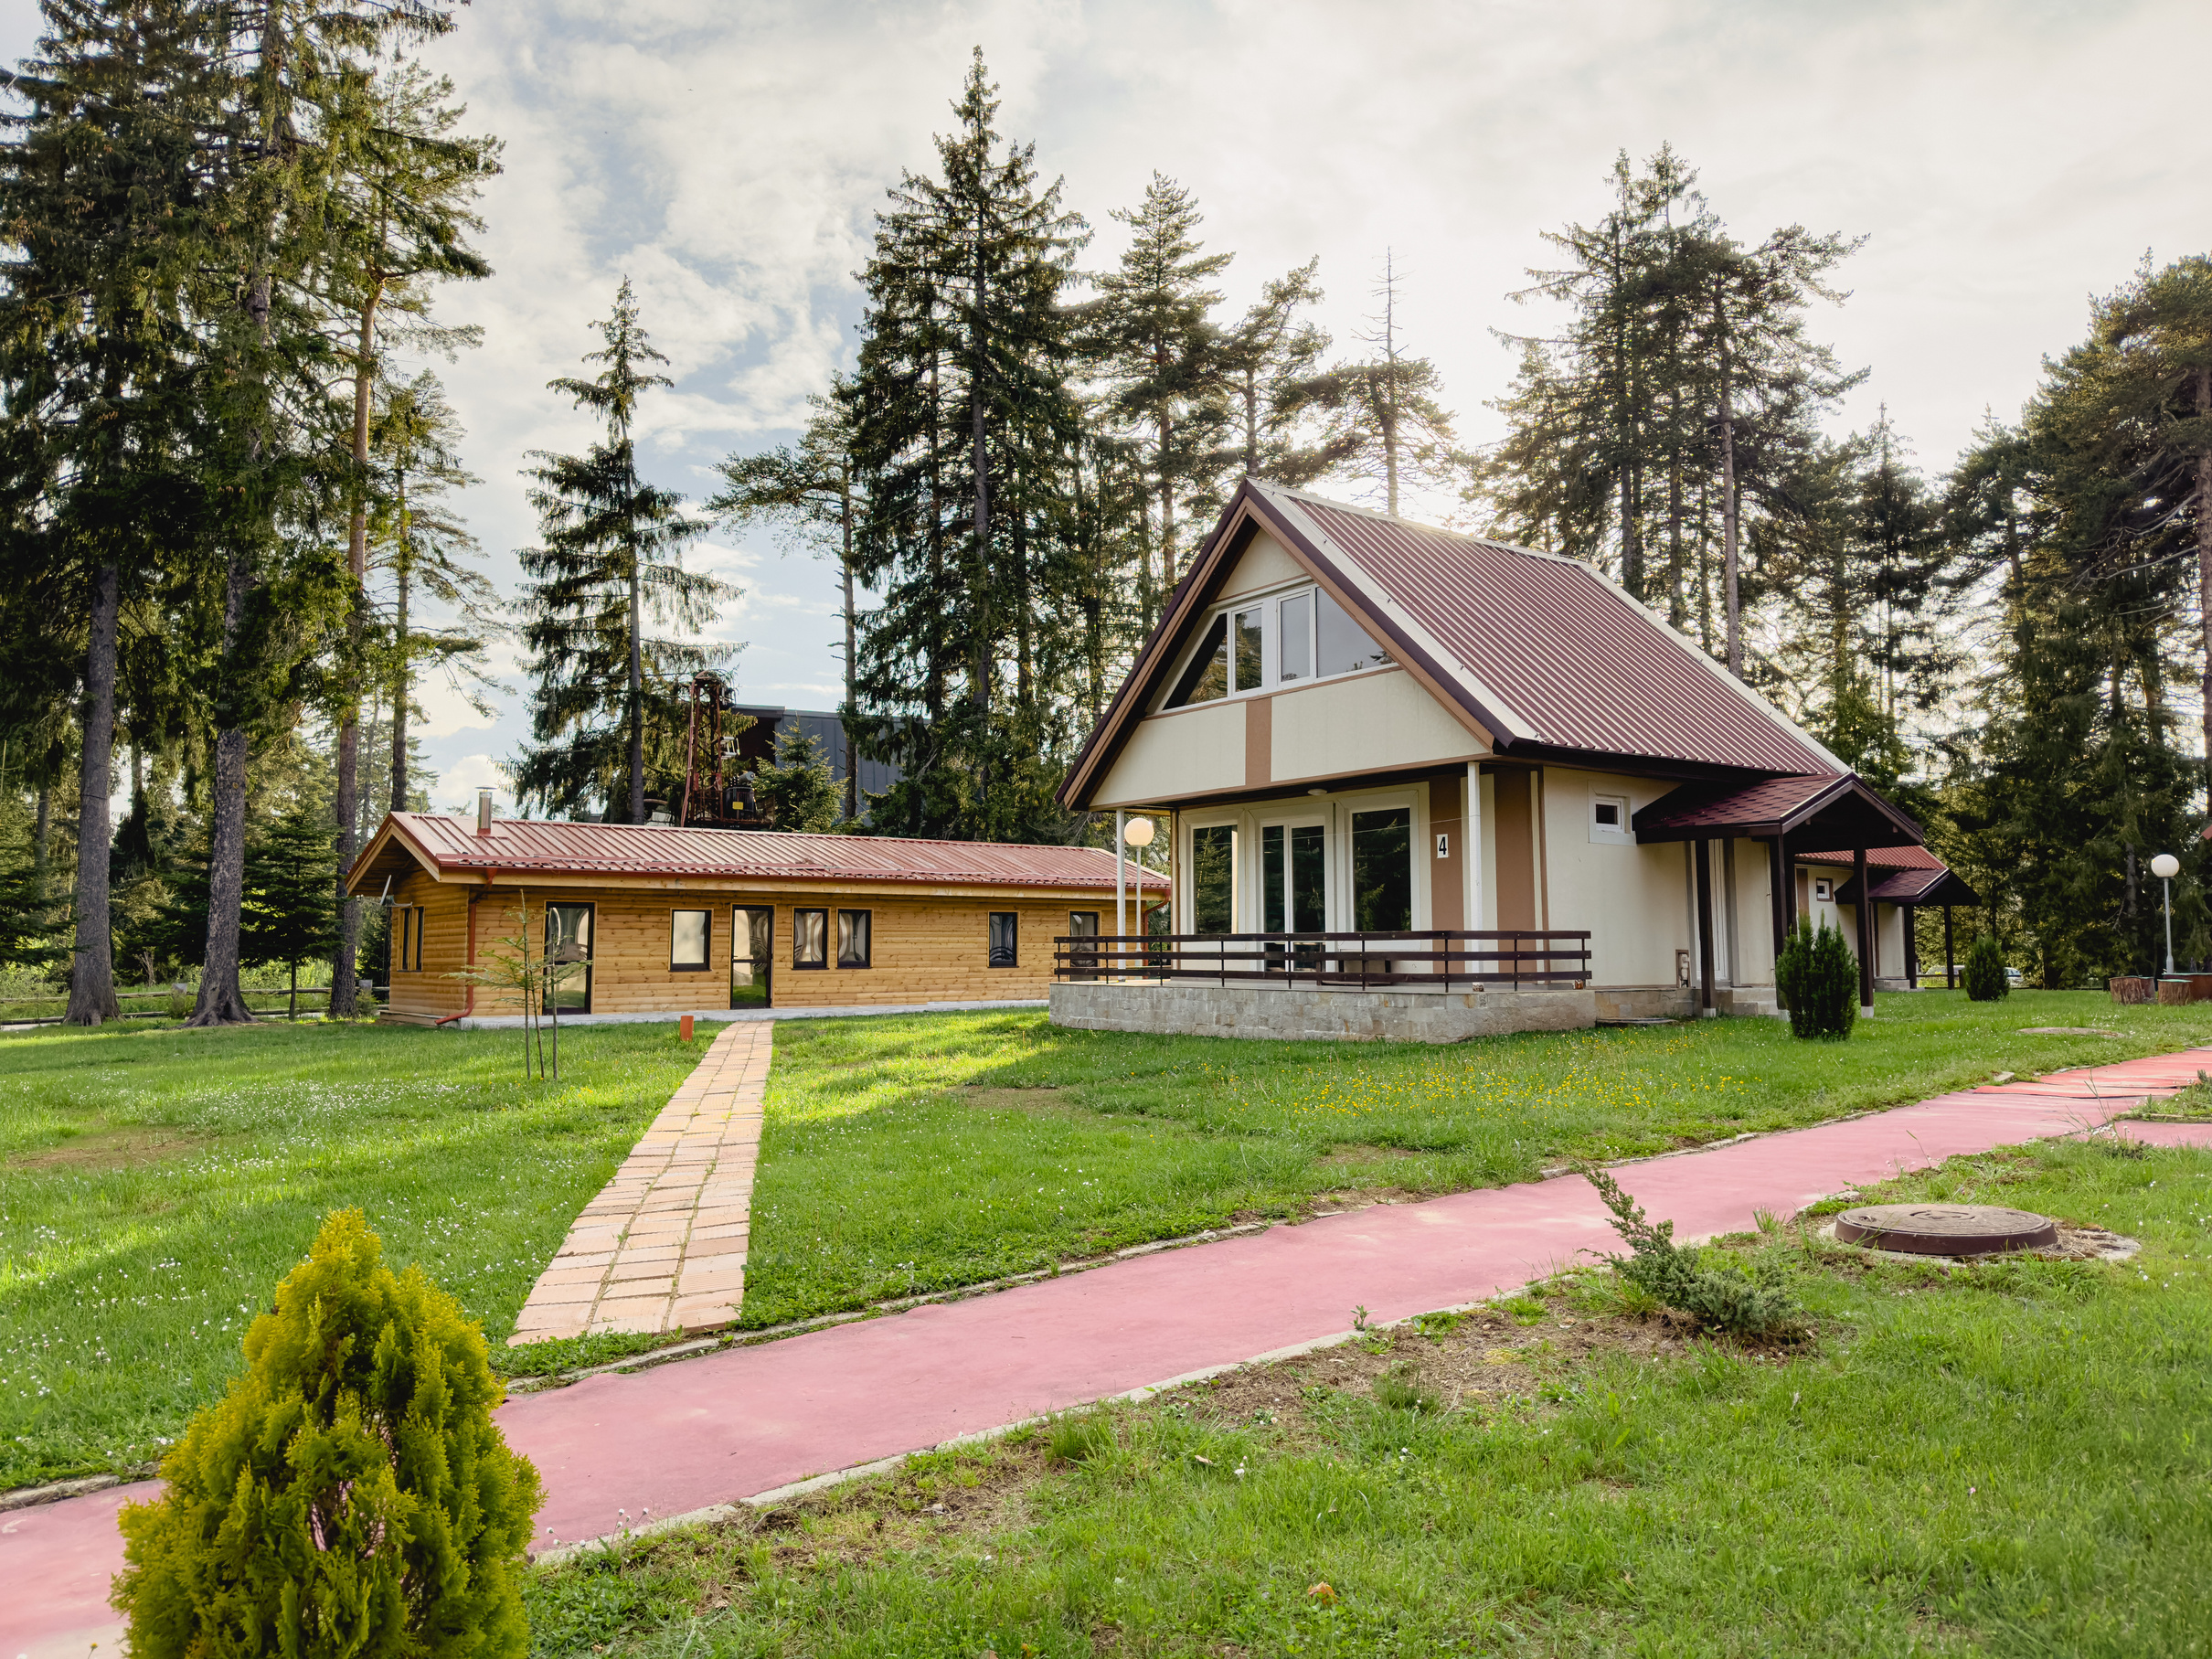


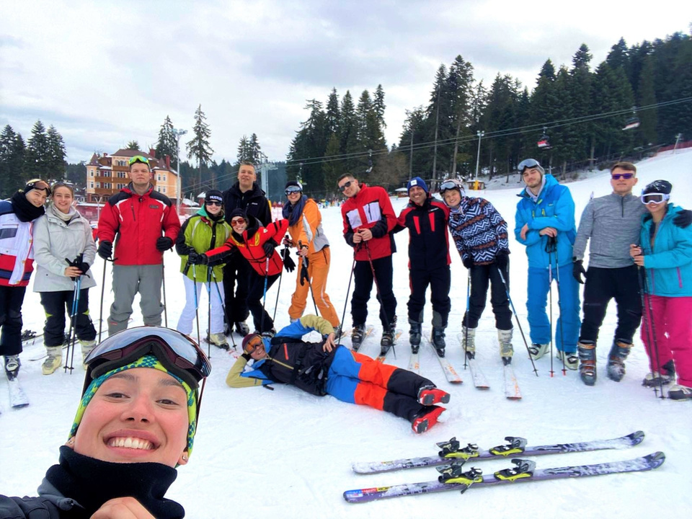
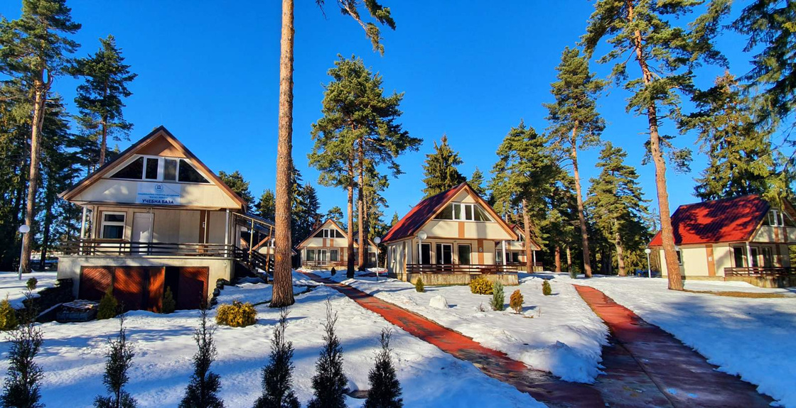
Education and Training outside Sofia
Borovets

Slide 16
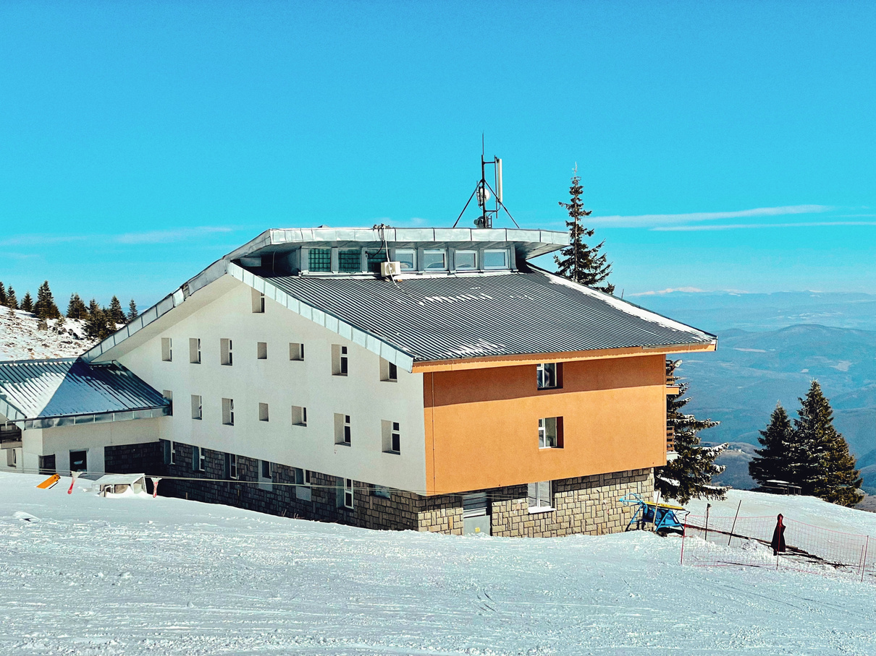

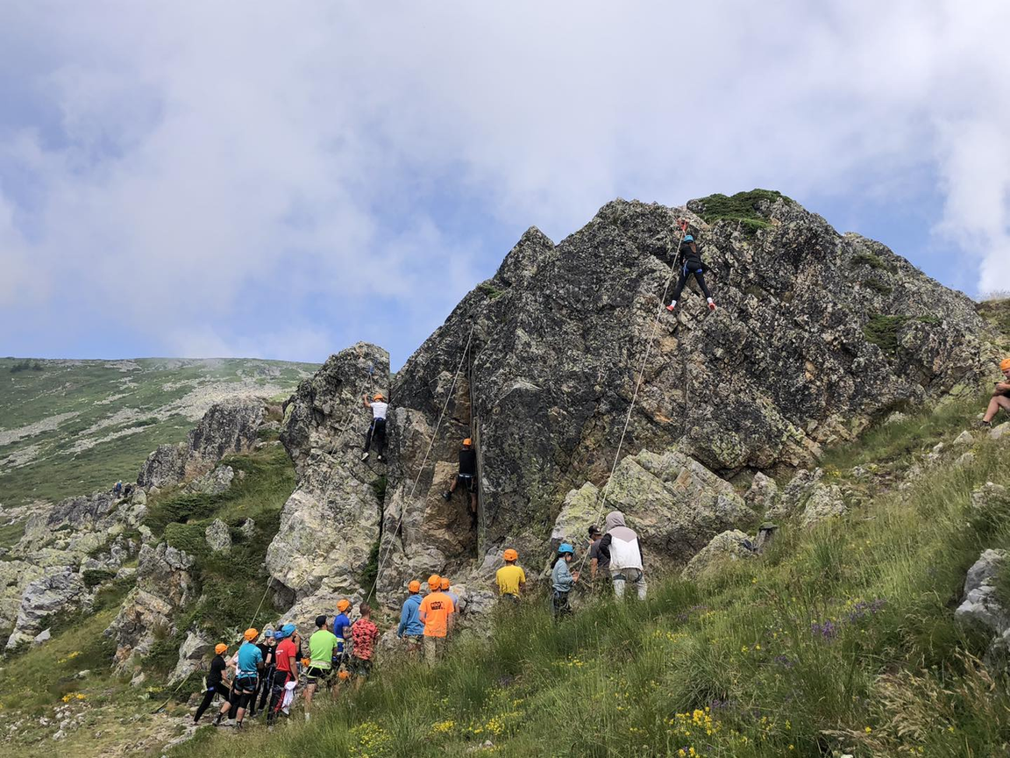
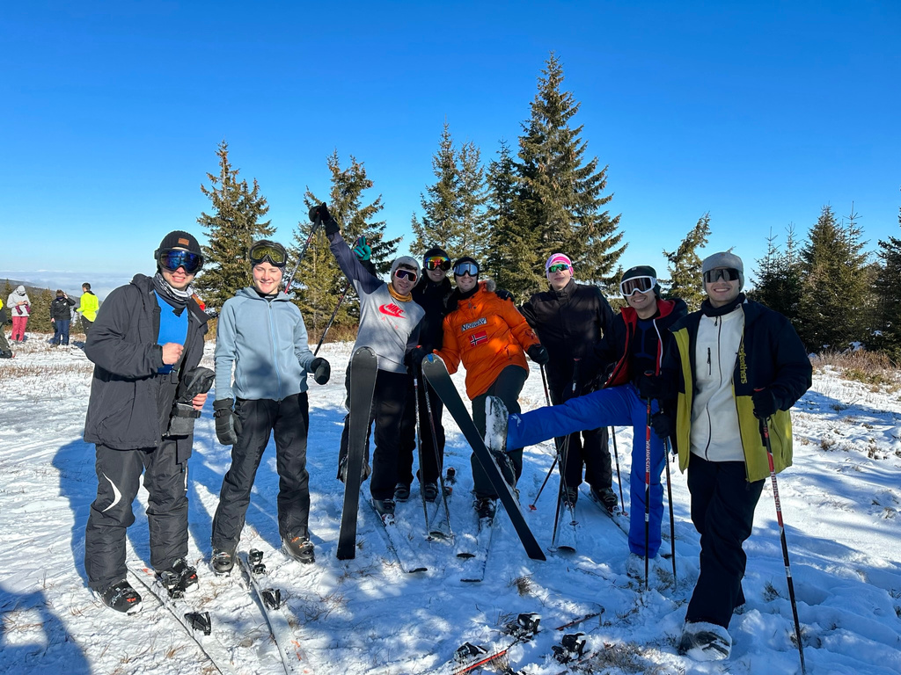
Education and Training outside Sofia
Vitosha
Two of the 3 compulsory courses for NSA students are held at the base. These are the ski course in winter and the TAO (Tourism, Alpinism and Orienteering) in summer.

Slide 17
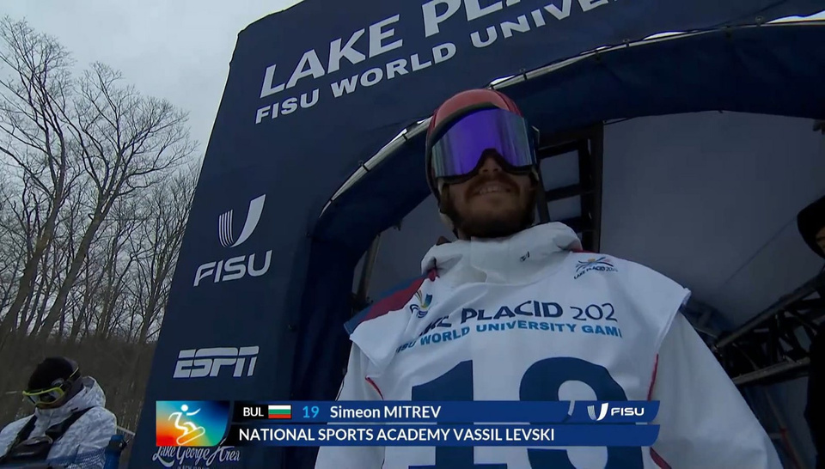
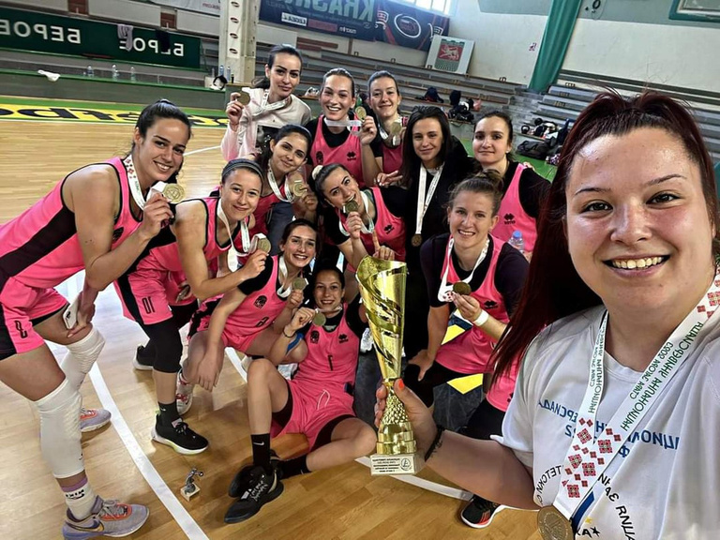
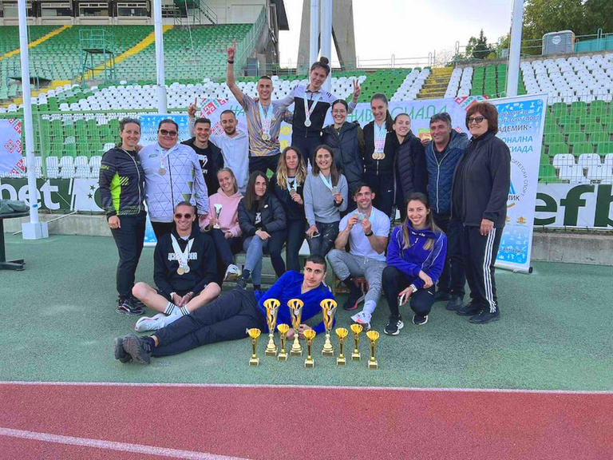
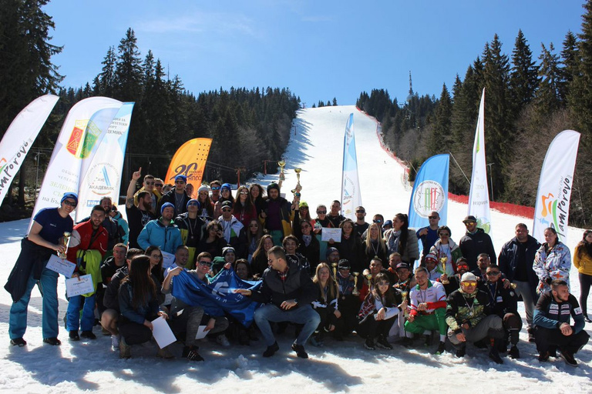
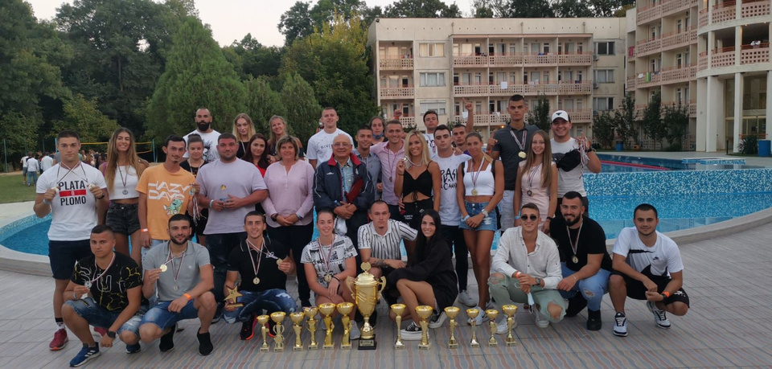
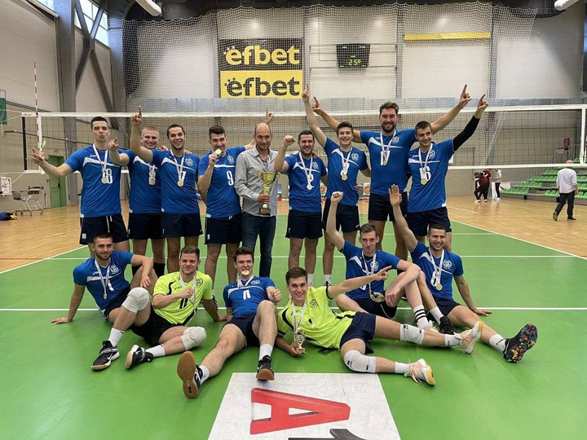
Competitions
Summer and Winter University Games at national and world level

Slide 18
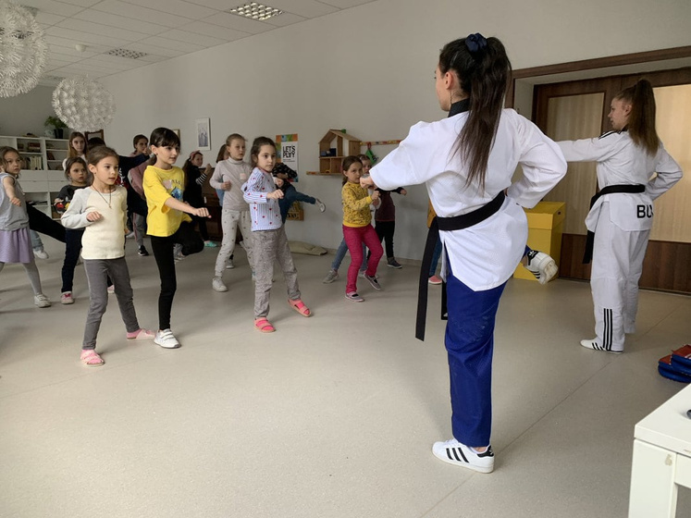
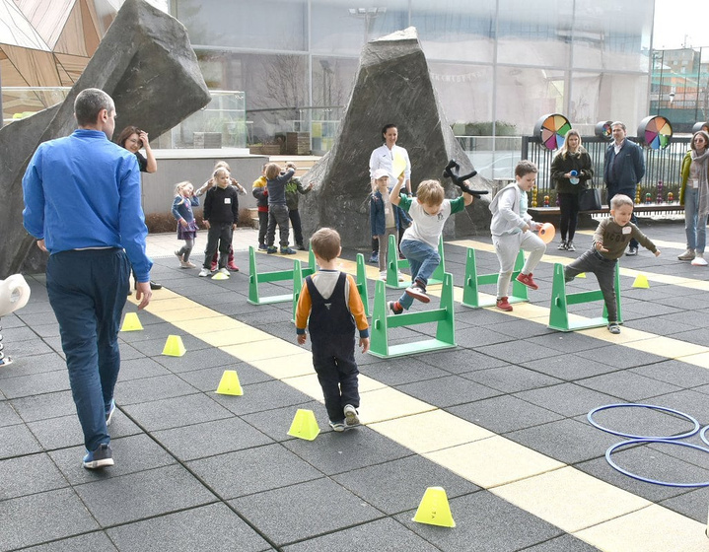
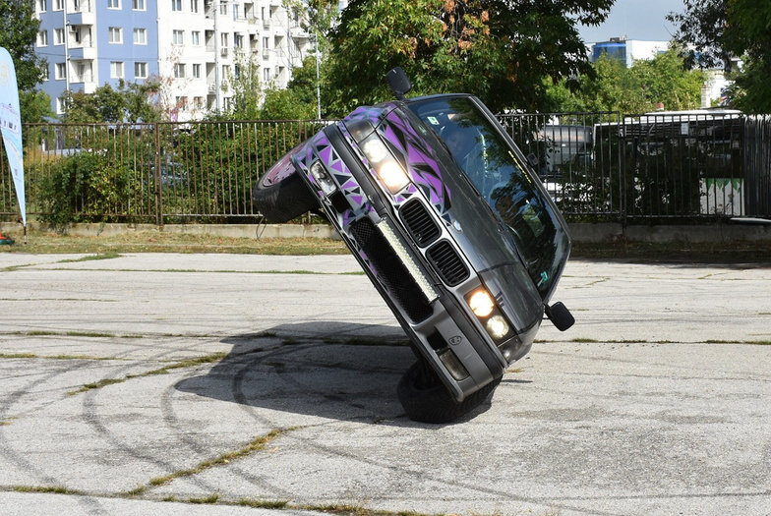

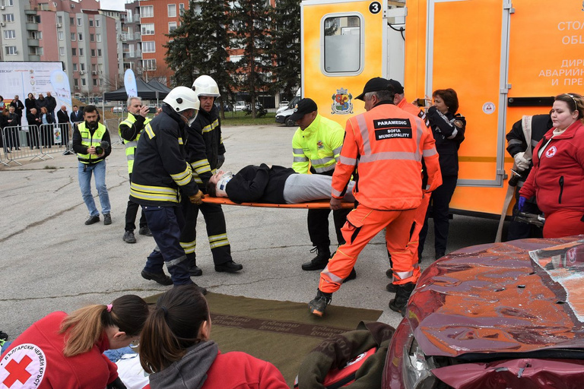
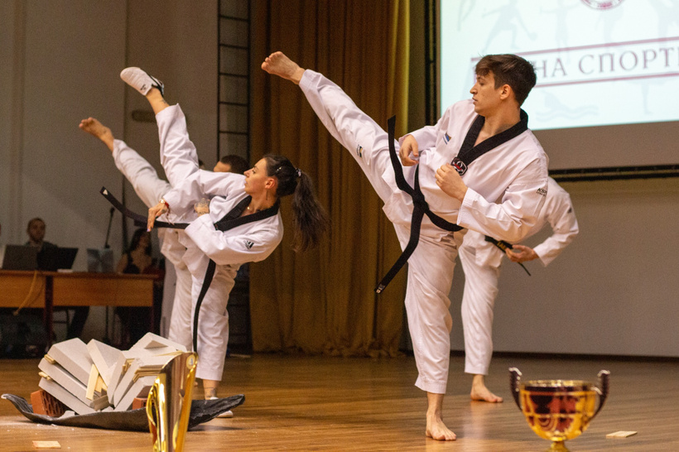
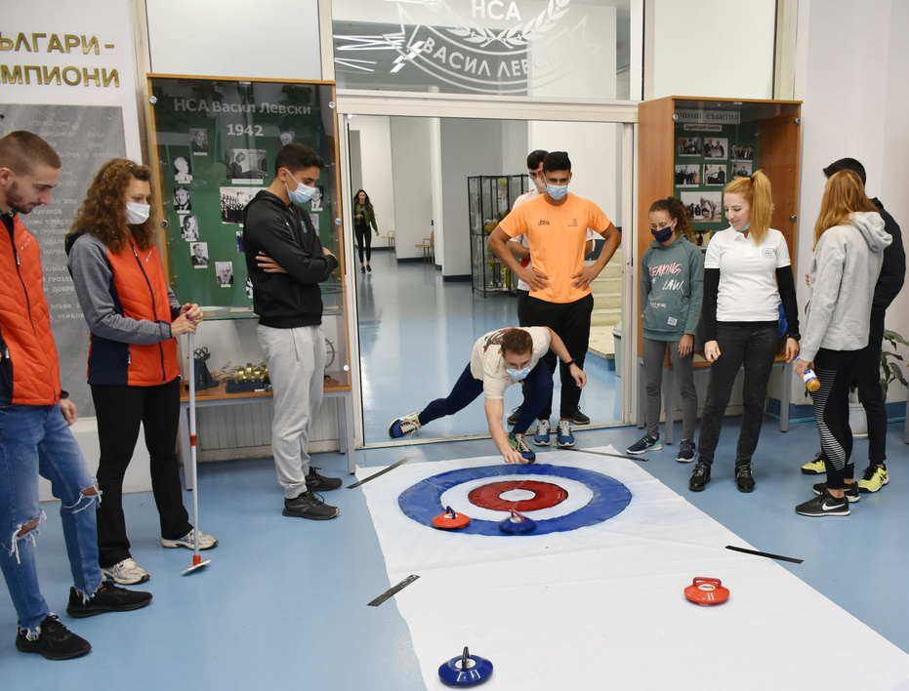
Different Sports Demonstrations

Slide 19
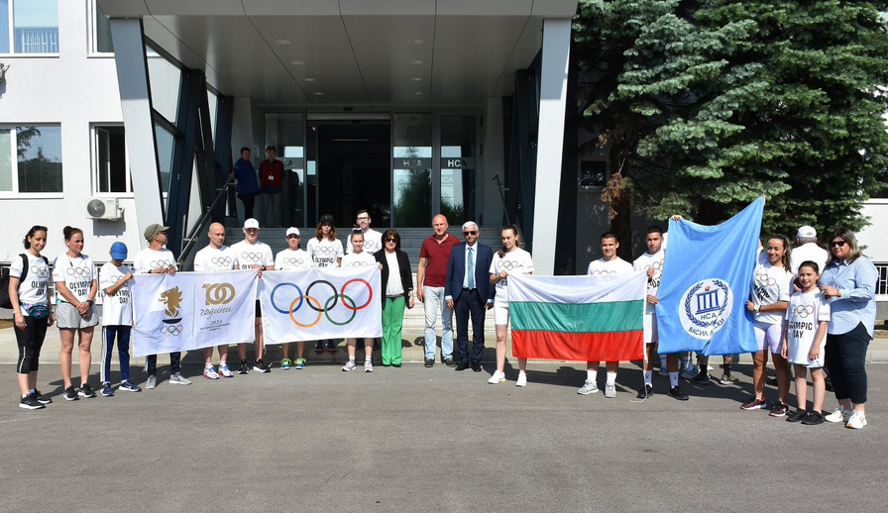
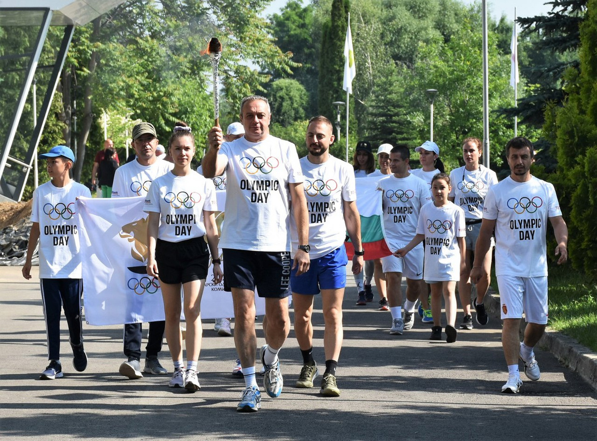
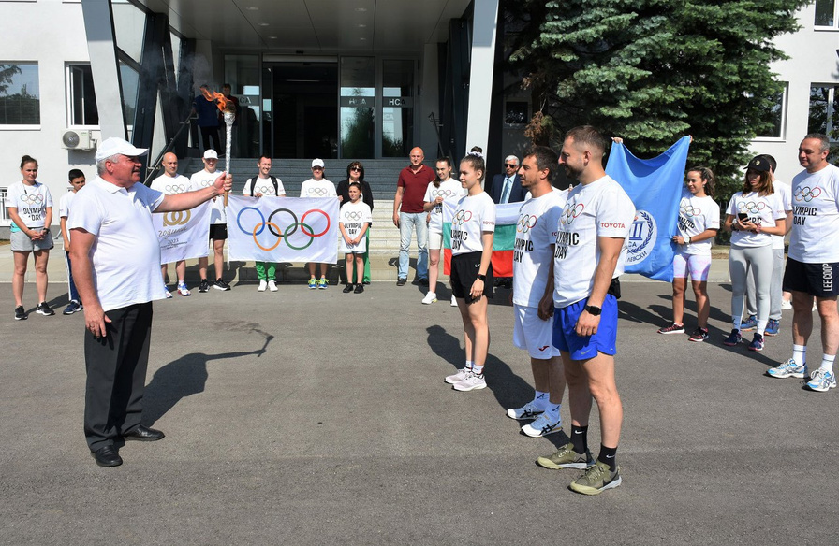
Olympic Movement

Slide 20
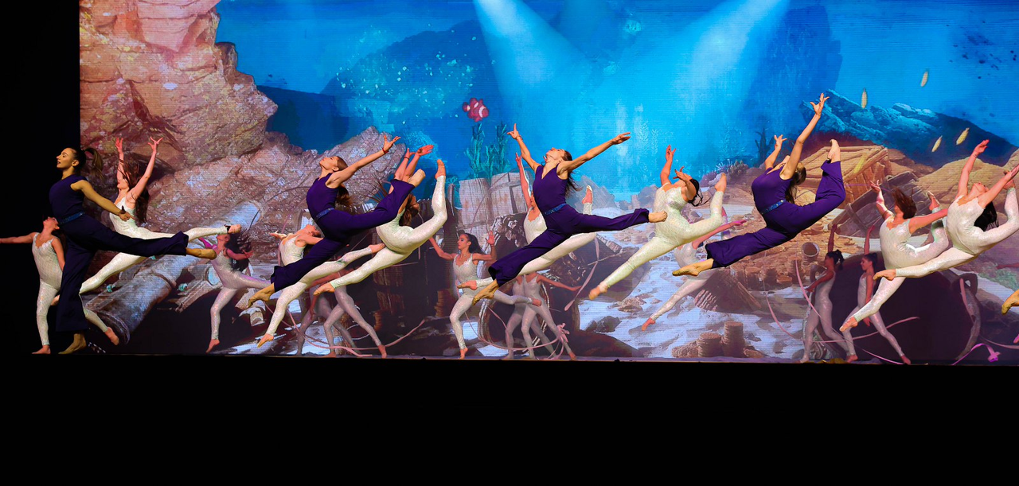
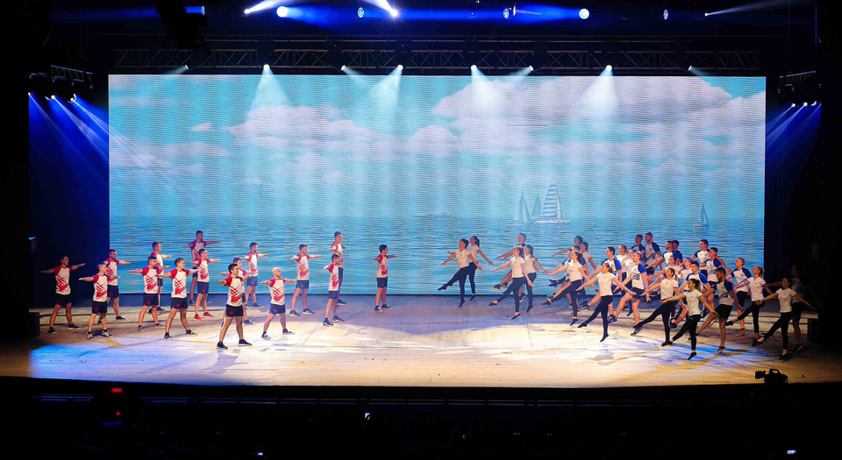
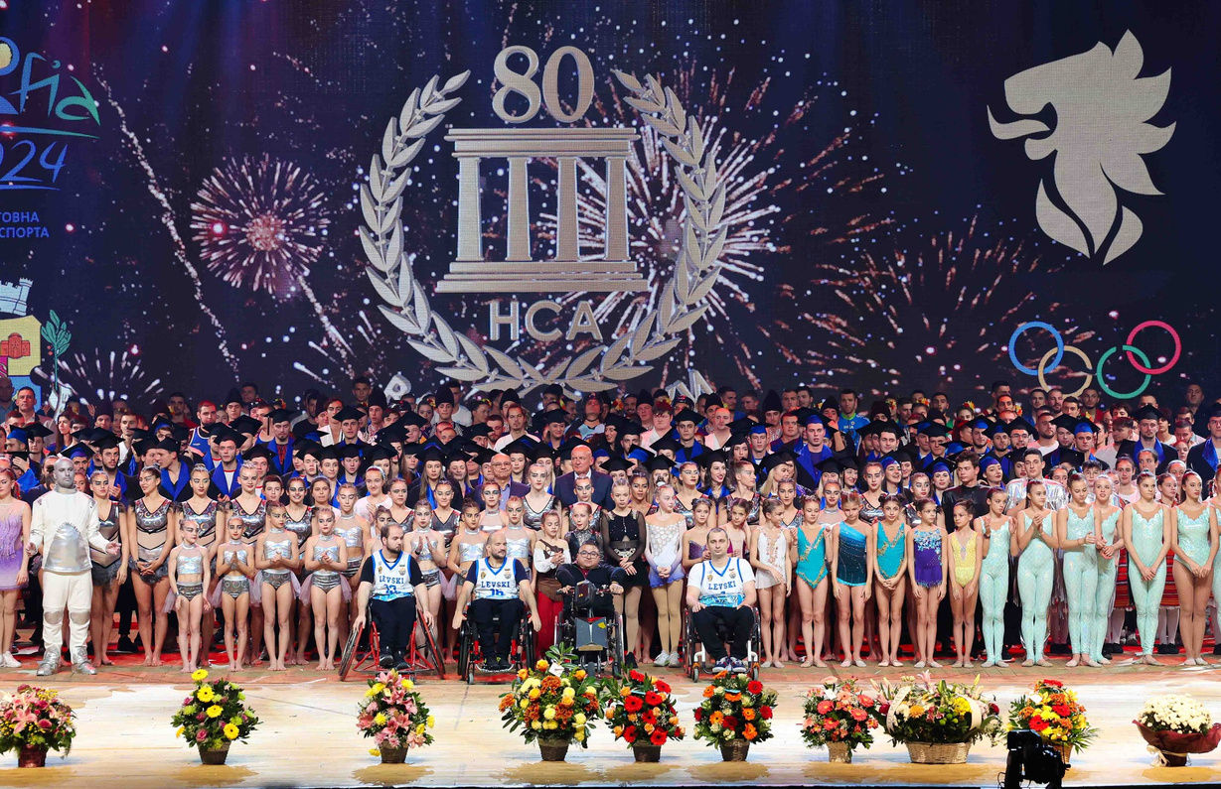
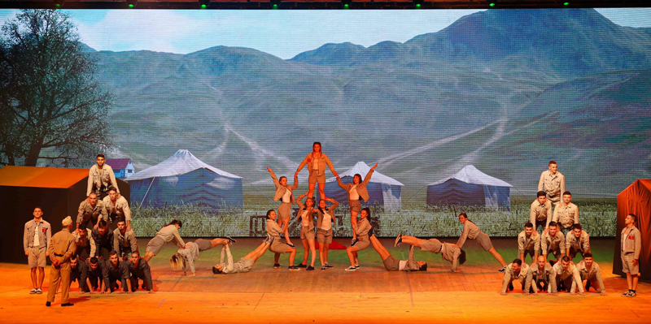
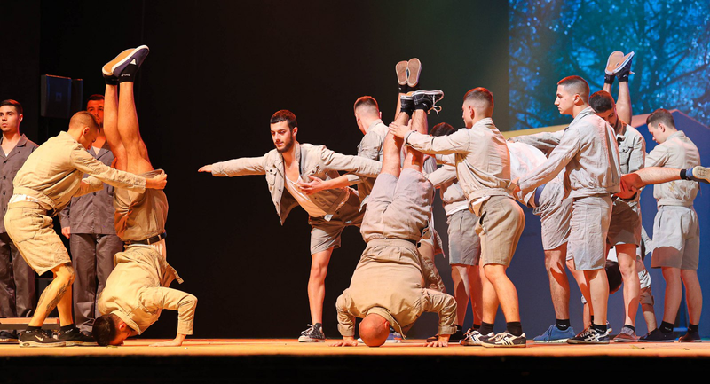
Sports show – students demonstrate all sports skills in a spectacular performance

Slide 21

National
Sports
Academy
"Vassil Levski”
Thank You
For Your Attention
Visit Our Website
nsa.bg

